Slide 1








Crime detection using deep learning
Kareem Ahmed El-Mallahy
195363
Supervisor: Doctor Ahmed Farouk

Slide 2
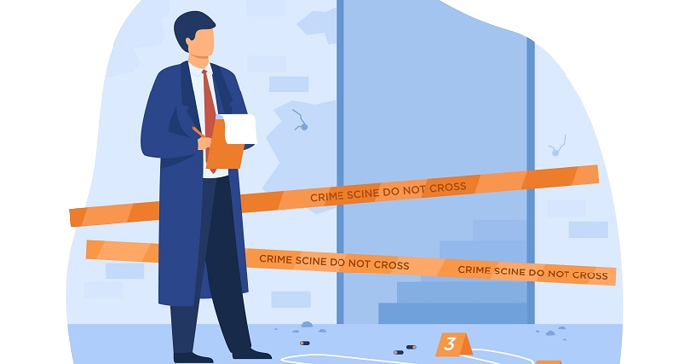
Agenda
Introduction
Problem Statement
Literature Review
Proposed Methodology
Results
Demo
Conclusion
References

Slide 3
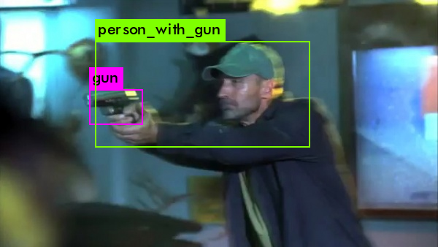
Introduction
What is Crime?
What are the Consequences of Crime?
Temporary
Endure lifetime
What is Crime Detection?
Discovery of the Crime
Suspect identification
Gathering evidence
How Crime detection could have helped us?

Slide 4

Problem Statement:
Building Intelligent is difficult.
System should learn from experience.
Deal with current data.
Unable to track all locations due to lack of manpower.

Slide 5
Crime prevention is everyone’s responsibility and One of our biggest problems is delayed reporting.
Harry Hall

Slide 6



Literature Review

Slide 7
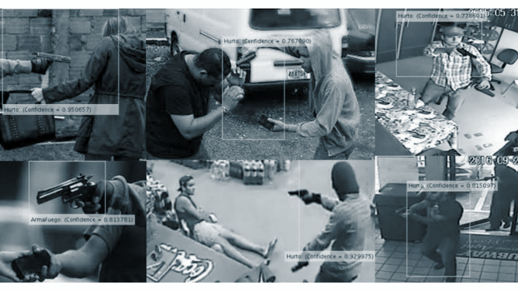
The Issue with the previous research are they were only detecting weapons

Slide 8
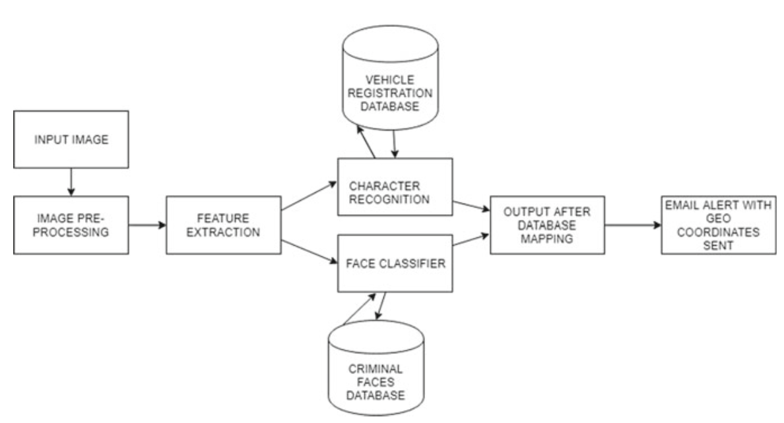
Factex: A Practical Approach to Crime Detection:
The main goal was to detect criminals while escaping.
Limitations:
Using OCR
Limited database
Results:
85% accuracy.

Slide 9
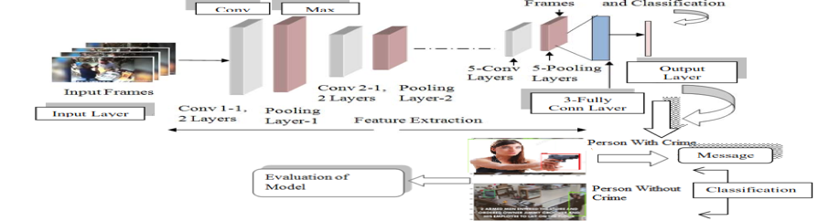
Crime Intention Detection System Using Deep Learning:
Goal was to detect weapons.
Limitations:
Was only detecting weapons.
Results:
92% with VGGnet-19.
69% with googleNet.

Slide 10
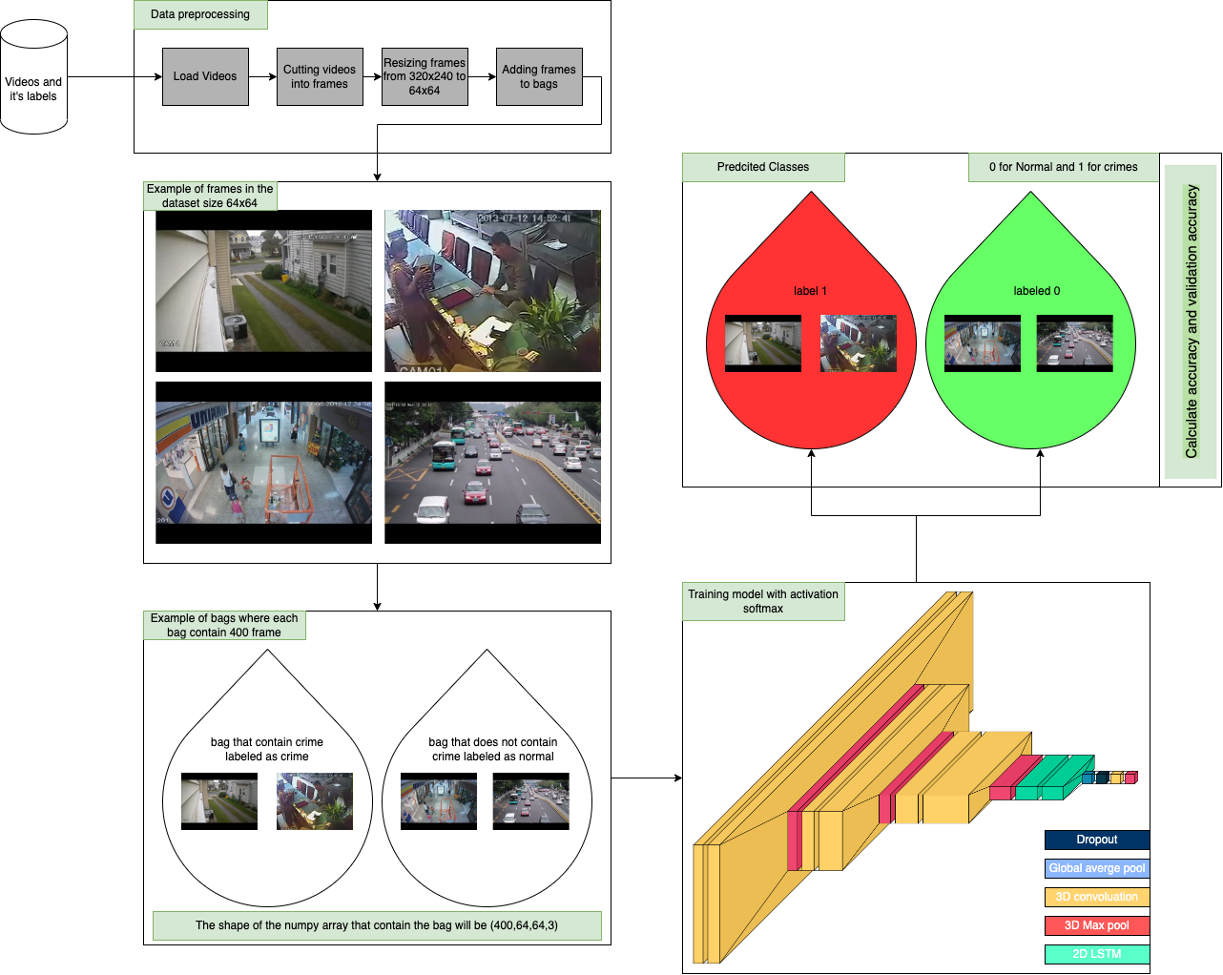
Proposed Methodology

Slide 11
Roadmap
Collected the Videos from internet
Preprocessed the data
Tested the model
1
3
5
2
4
Analyzed the data
Trained the Model

Slide 12
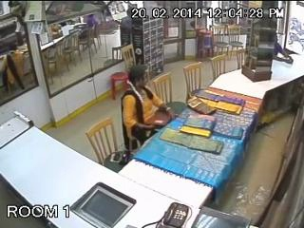
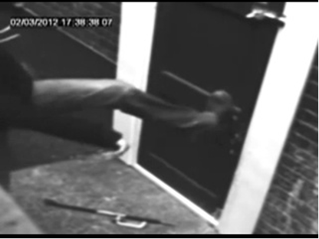
Dataset:
UCF-crime Dataset.
13 type of crime and normal type.
1900 Video.
128 of extensive, uncut surveillance recording.
60% for training, 20% for Validation, 20% for testing

Slide 13
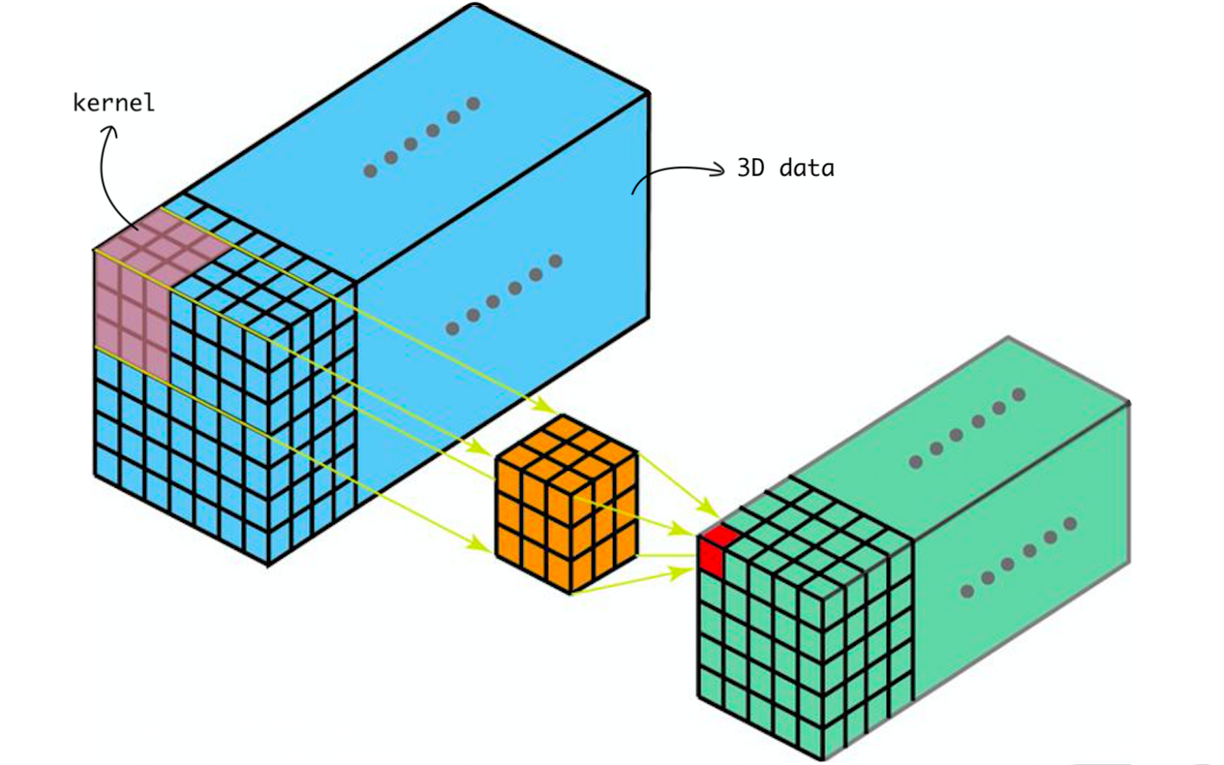
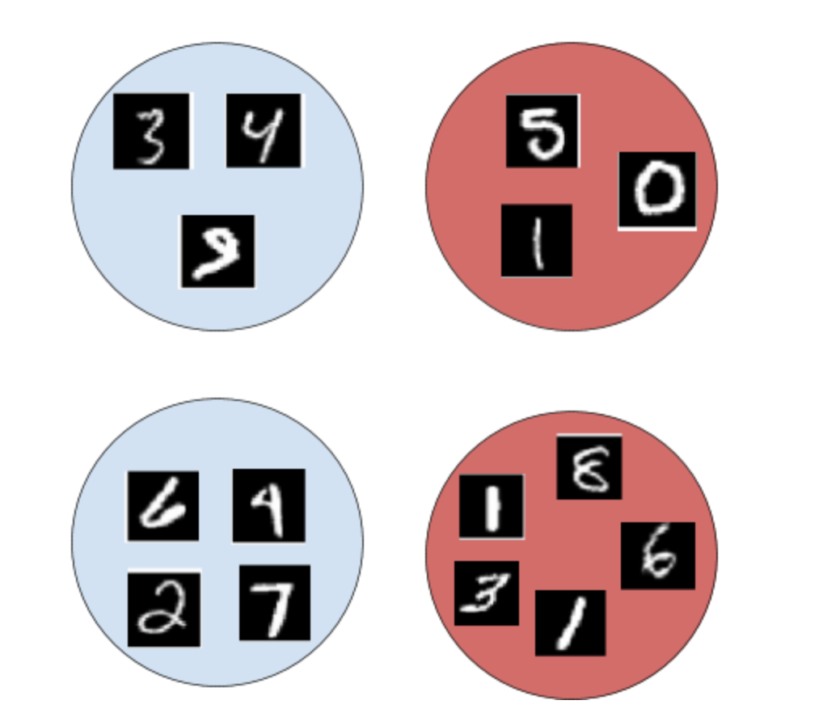
Proposed Methodology
3D Convolution (3D CNN):
It is a type of Convolution Neural Network where the kernel size is 3 dimension.
Long Short Term Memory (LSTM):
A unique version of RNN called LSTM show excellent performance on a wide range of issues.
Multiple Instance Learning (MIL):
algorithm for supervised learning in which training data is organised into bags, each of which contains a set of instances.

Slide 14
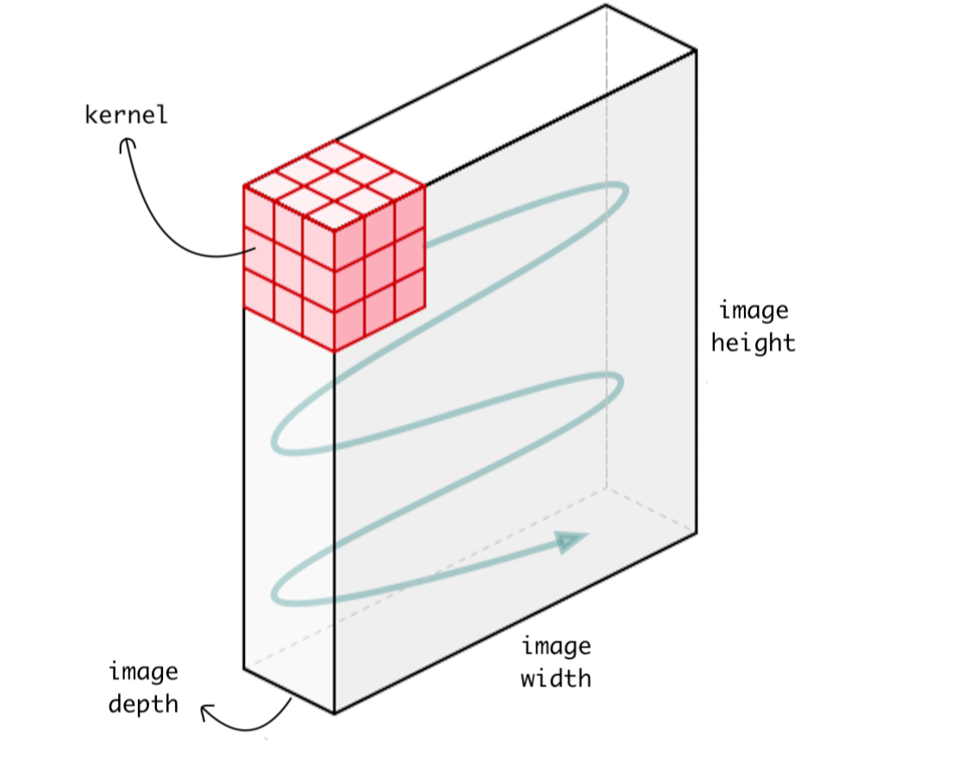
2D-Convolution and 3D-Convolution

Slide 15
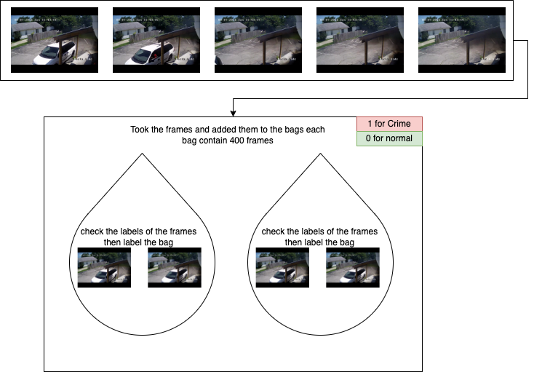
Data Preprocessing:
Cut the videos into frames.
Resize the frames to 64x64.
Add frames to the bags (MIL).
Each bag will contain 400 frames.
Label each bag (1 for crime and 0 for normal).

Slide 16
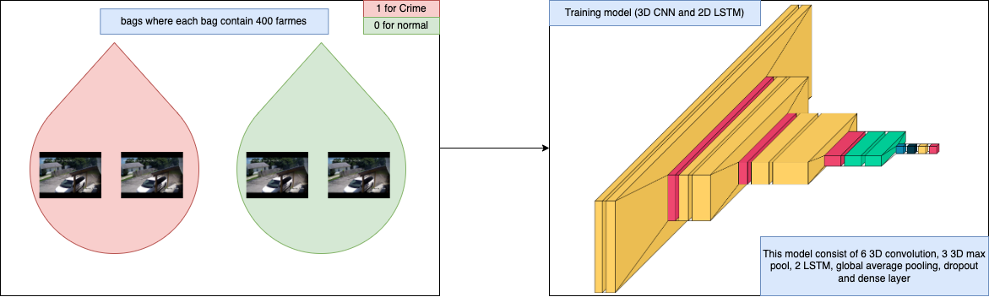
Model Training:
Start by passing the bags to model.
Model consist of:
6 3D convolution layers
3 3D Max Pooling.
2 LSTM layers.
Dense Layer (units = 2)

Slide 17
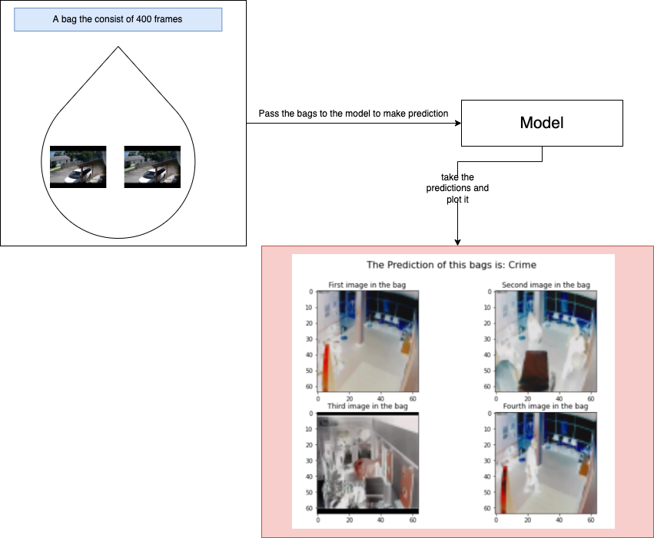
Model Testing:
Reading the test data.
Add the test data to bags (MIL).
Make the Predictiction.

Slide 18
Results:
Model number | Number of convolution layers | Number of LSTM layers | Kernel size | strides | padding | Batch size | Training accuracy | Validation accuracy | Testing accuracy
Model 1 | 4 layers | 0 layers | 3x3x3 | 1x1x1 | Valid | 20 | 49% | 66% | 50%
Model 2 | 4 layers | 0 layers | 3x3x3 | 1x1x1 | Valid | 10 | 99% | 100% | 50%
Model 3 | 6 layers | 0 layers | 6x3x3 | 1x1x1 | valid | 10 | 92% | 100% | 50%
Model 4 | 6 layers | 0 layers | 3x3x3 | 1x1x1 | valid | 10 | 70% | 50% | 70%
Model 5 | 6 layers | 2 layers | 3x3x3 | 1x1x1 | valid | 10 | 87% | 90% | 95%

Slide 19
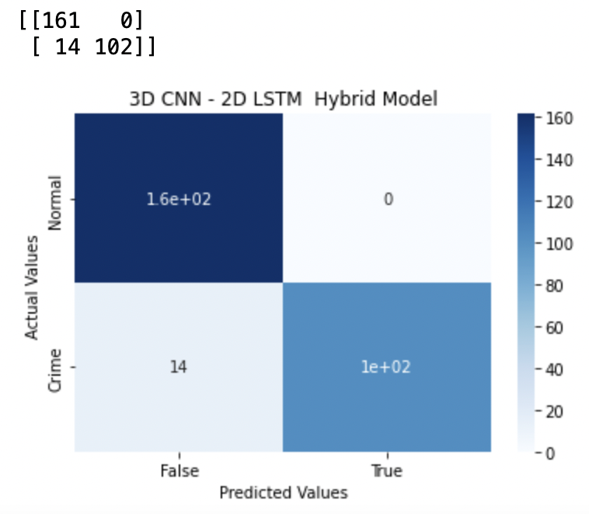
Results:

Slide 20
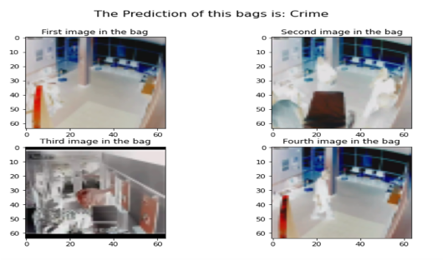
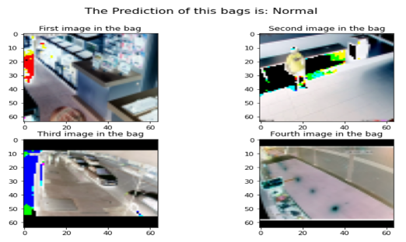
Results:

Slide 21

Demo

Slide 22
Conclusion
Used MIL algorithm.
3
Hybrid model consist of CNN, RNN.
2
crime detection system.
1

Slide 23

Future Work
Classify between the 13 type of Crime
This will Make the system more automated.

Slide 24
References
1. Dorogyy, Y., Kolisnichenko, V., & Levchenko, K. (2018, September). Violent crime detection system. In 2018 IEEE 13th international scientific and technical conference on computer sciences and information technologies (CSIT) (Vol. 1, pp. 352-355). IEEE.
2. Samuel, D. J., & Cuzzolin, F. (2021). SVD-GAN for Real-Time Unsupervised Video Anomaly Detection.
3. S. Chackravarthy, S. Schmitt and L. Yang, "Intelligent Crime Anomaly Detection in Smart Cities Using Deep Learning," 2018 IEEE 4th International Conference on Collaboration and Internet Computing (CIC), 2018, pp. 399-404, doi: 10.1109/CIC.2018.00060.
4. Unsolved Homicides. (n.d.). Kansas City Missouri Police Department. Retrieved November 10, 2021, from https://www.kcpd.org/crime/unsolved-homicides/
5. Jonas DE, Wilkins TM, Bangdiwala S, et al. Findings of Bayesian Mixed Treatment Comparison Meta-Analyses: Comparison and Exploration Using Real-World Trial Data and Simulation [Internet]. Rockville (MD): Agency for Healthcare Research and Quality (US); 2013 Feb. Table 20, Advantages and disadvantages of the Bayesian MTC approach. Available from: https://www.ncbi.nlm.nih.gov/books/NBK126112/table/discussion.t1/
6. Jain, R., Nayyar, A., & Bachhety, S. (2020). Factex: a practical approach to crime detection. In Data Management, Analytics and Innovation (pp. 503-516). Springer, Singapore.
7. Council, G. (2018). Using OCR: How Accurate is Your Data? | Transforming Data with Intelligence. Retrieved 25 February 2022, from https://tdwi.org/articles/2018/03/05/diq-all- how-accurate-is-your-data.aspx#:~:text=Leveraging%20Your%20Document%20Data&text=Obviously%2C%20the%20accuracy%20of%20the,level%20of%20accuracy%20is%20acceptable.
8. U. V. Navalgund and P. K., "Crime Intention Detection System Using Deep Learning," 2018 International Conference on Circuits and Systems in Digital Enterprise Technology (ICCSDET), 2018, pp. 1-6, doi: 10.1109/ICCSDET.2018.8821168.
9. Gupta, A. (2022). Difference between ANN, CNN and RNN - GeeksforGeeks. Retrieved 25 February 2022, from https://www.geeksforgeeks.org/difference-between-ann-cnn-and-rnn/.
10. Advantages and Disadvantages of TensorFlow. (2022). Retrieved 26 February 2022, from https://techvidvan.com/tutorials/pros-and-cons-of-tensorflow/
11.Sung, CS., Park, J.Y. Design of an intelligent video surveillance system for crime prevention: applying deep learning technology. Multimed Tools Appl (2021). https://doi.org/10.1007/s11042-021-10809-z.
12. Advantages of Deep Learning | disadvantages of Deep Learning. (2022). Retrieved 26 February 2022, from https://www.rfwireless-world.com/Terminology/Advantages-and-Disadvantages-of-Deep-Learning.html.
13. K-Nearest Neighbor(KNN) Algorithm for Machine Learning - Javatpoint. (2022). Retrieved 26 February 2022, from https://www.javatpoint.com/k-nearest-neighbor-algorithm-for-machine-learning.

Slide 25
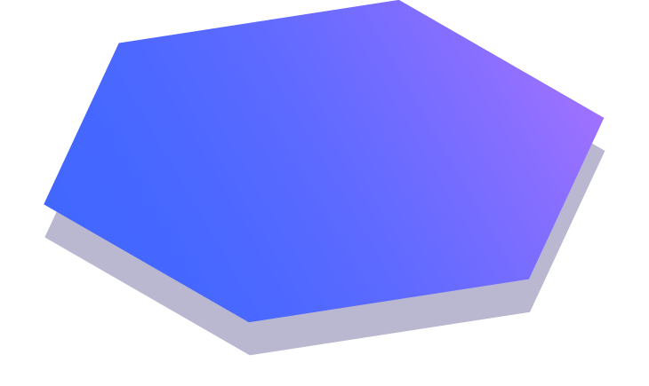
Thanks
Any questions?

